Slide 1


Joint Action
without Shared Intention

Slide 2
shared intention*
...
...
...
shared goals
collective goals
joint action
“group activity”
*(presupposes sophisticated theory of mind cognition)
Notes:
This is an overview of the project and its aims

Slide 3
first
half
Notes:
This is an overview of the project and its aims

Slide 4
What is the relation between a joint action and the goal (or goals) to which it is directed?

Slide 5

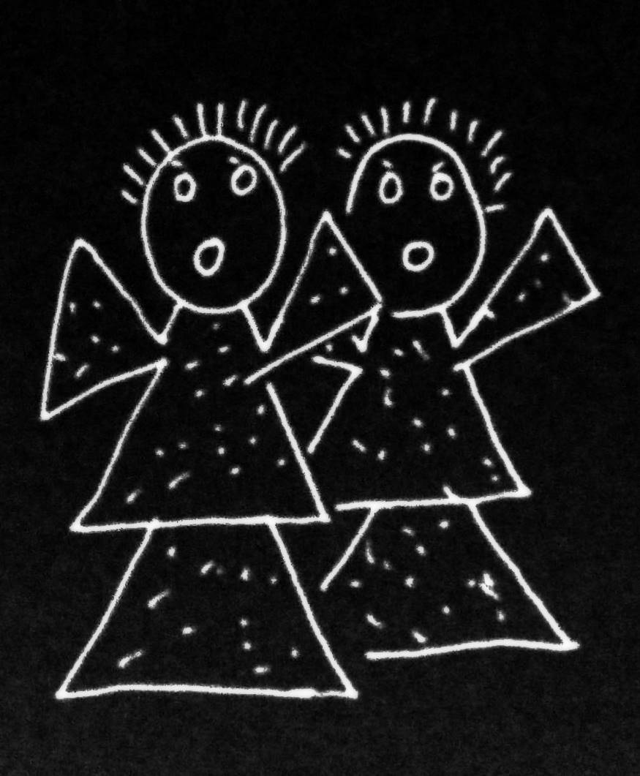
What is the relation between a joint action and the goal (or goals) to which it is directed?

Slide 6
What is the relation between a joint action and the goal (or goals) to which it is directed?

Slide 7
What is the relation between a joint action and the goal (or goals) to which it is directed?

Slide 8
an individual
What is the relation between a joint action and the goal (or goals) to which it is directed?
intention
behaviours
goal-state
goal-outcome
coordinates
specifies

Slide 9

‘I take a collective action to involve a collective [shared] intention.’
‘the key property of joint action lies in its internal component [...] in the participants’ having a “collective” or “shared” intention.’
(Facundo Alonso, 2009, pp. 444-5)
‘Shared intentionality is the foundation upon which joint action is built.’
(Carpenter 2009, p. 381)

Slide 10
‘I take a collective action to involve a collective [shared] intention.’
‘the key property of joint action lies in its internal component [...] in the participants’ having a “collective” or “shared” intention.’
(Facundo Alonso, 2009, pp. 444-5)
‘Shared intentionality is the foundation upon which joint action is built.’
(Carpenter 2009, p. 381)

Slide 11
What is the relation between a joint action and the goal (or goals) to which it is directed?
shared intention
behaviours
goal-state
goal-outcome
coordinates
specifies

Slide 12
What is the relation between a joint action and the goal (or goals) to which it is directed?
- The goal of Ayesha and Beatrice’s action is to free the cat.
- It is not true that Ayesha and Beatrice have a shared intention. Nor any other kind of shared goal-state.
shared intention
behaviours
goal-state
goal-outcome
coordinates
specifies

Slide 13
What is the relation between a joint action and the goal (or goals) to which it is directed?
- The goal of Ayesha and Beatrice’s action is to free the cat.
- It is not true that Ayesha and Beatrice have a shared intention. Nor any other kind of shared goal-state.
shared intention
behaviours
goal-state
goal-outcome
coordinates
specifies

Slide 14
shared intention

Slide 15
awareness of joint-ness
at least one of the agents knows that they are not acting individually; she or they have ‘a conception of themselves as contributors to a collective end.’
awareness of others’ agency
at least one of the agents is aware of one or more of the others as an intentional agent.
awareness of others’ states or commitments
at least one of the agents who are F-ing is aware of, or has individuating beliefs about, some of the others’ intentions, beliefs or commitments concerning F.

Slide 16
awareness of joint-ness
at least one of the agents knows that they are not acting individually; she or they have ‘a conception of themselves as contributors to a collective end.’
awareness of others’ agency
at least one of the agents is aware of one or more of the others as an intentional agent.
awareness of others’ states or commitments
at least one of the agents who are F-ing is aware of, or has individuating beliefs about, some of the others’ intentions, beliefs or commitments concerning F.

Slide 17
awareness of joint-ness
at least one of the agents knows that they are not acting individually; she or they have ‘a conception of themselves as contributors to a collective end.’
awareness of others’ agency
at least one of the agents is aware of one or more of the others as an intentional agent.
awareness of others’ states or commitments
at least one of the agents who are F-ing is aware of, or has individuating beliefs about, some of the others’ intentions, beliefs or commitments concerning F.

Slide 18
awareness of joint-ness
at least one of the agents knows that they are not acting individually; she or they have ‘a conception of themselves as contributors to a collective end.’
awareness of others’ agency
at least one of the agents is aware of one or more of the others as an intentional agent.
awareness of others’ states or commitments
at least one of the agents who are F-ing is aware of, or has individuating beliefs about, some of the others’ intentions, beliefs or commitments concerning F.

Slide 19
awareness of joint-ness
at least one of the agents knows that they are not acting individually; she or they have ‘a conception of themselves as contributors to a collective end.’
awareness of others’ agency
at least one of the agents is aware of one or more of the others as an intentional agent.
awareness of others’ states or commitments
at least one of the agents who are F-ing is aware of, or has individuating beliefs about, some of the others’ intentions, beliefs or commitments concerning F.

Slide 20
joint action

Slide 21
The agents’ activities have a single goal.*
This isn’t just a matter of each individual agent’s activities having that goal.
[*could be weakened]

Slide 22
The agents’ activities have a single goal.*
This isn’t just a matter of each individual agent’s activities having that goal.
[*could be weakened]
parcel caught
Many agents, one outcome there is a single outcome to which each agent’s activities are individually directed.

Slide 23
joint action without shared intention

Slide 24
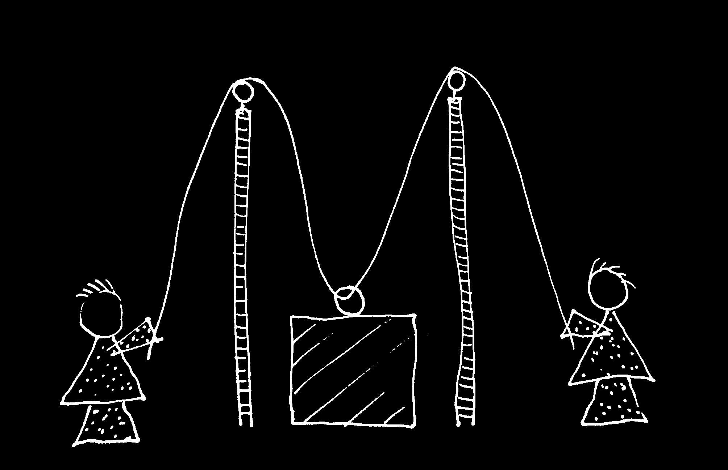
cf. Vesper et al (forthcoming)

Slide 25


Slide 26
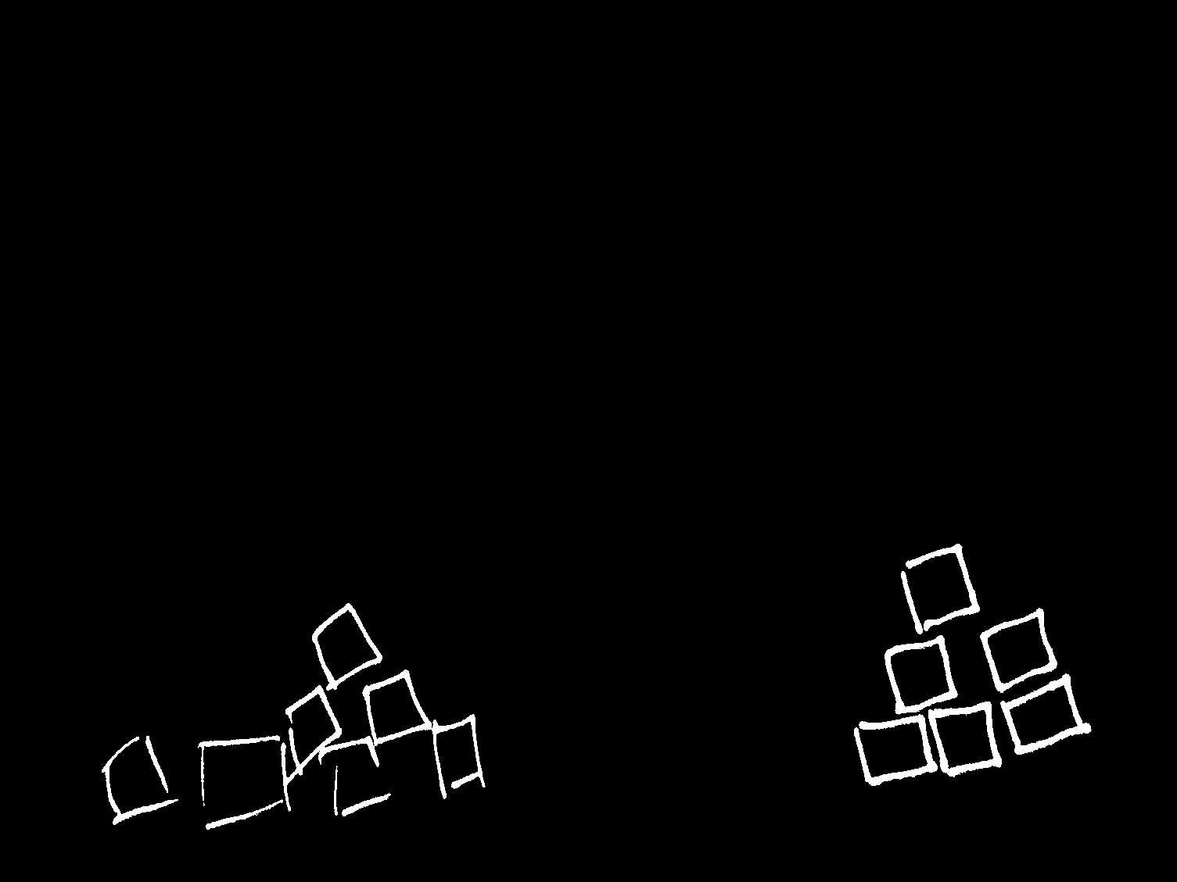

Slide 28
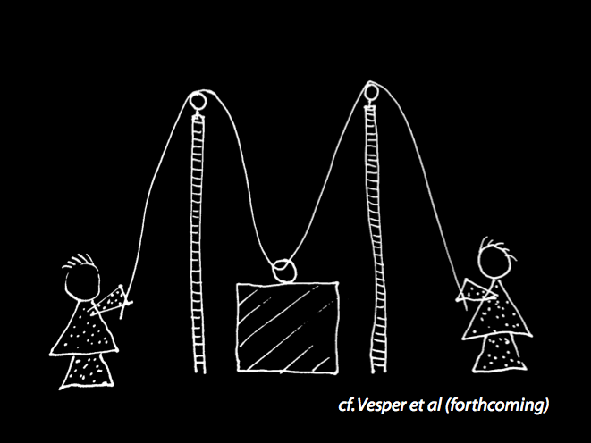

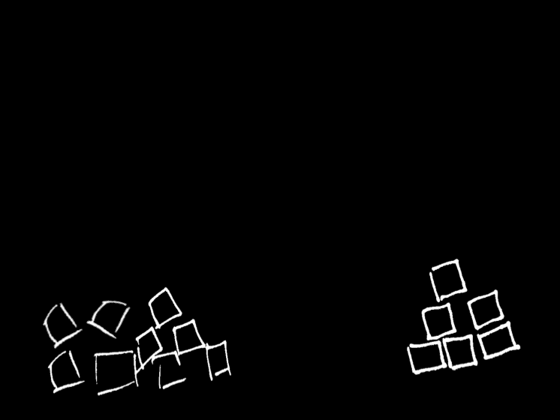

Slide 29
How can we characterise the relation between joint actions and their goal-outcomes without invoking shared intentions?

Slide 30
parcel caught
distributive goal
Many agents, one outcome there is a single outcome to which each agent’s activities are individually directed.

Slide 31
There is a single goal-outcome such that each agent’s activities are directed to it (a distributive goal).
The agents’ activities are coordinated.
The goal-outcome would normally occur partly as a consequence of this coordination, or would normally be partly constituted by it

Slide 32
There is a single goal-outcome such that each agent’s activities are directed to it (a distributive goal).
The agents’ activities are coordinated.
The goal-outcome would normally occur partly as a consequence of this coordination, or would normally be partly constituted by it
collective goal

Slide 33
How can we characterise the relation between joint actions and their goal-outcomes without invoking shared intentions?
There is a single goal-outcome such that each agent’s activities are directed to it (a distributive goal).
The agents’ activities are coordinated.
The goal-outcome would normally occur partly as a consequence of this coordination, or would normally be partly constituted by it
collective goal

Slide 34
How can we characterise the relation between joint actions and their goal-outcomes without invoking shared intentions?
There is a single goal-outcome such that each agent’s activities are directed to it (a distributive goal).
The agents’ activities are coordinated.
The goal-outcome would normally occur partly as a consequence of this coordination, or would normally be partly constituted by it
collective goal

Slide 35
How can we characterise the relation between joint actions and their goal-outcomes without invoking shared intentions?
There is a single goal-outcome such that each agent’s activities are directed to it (a distributive goal).
The agents’ activities are coordinated.
The goal-outcome would normally occur partly as a consequence of this coordination, or would normally be partly constituted by it
collective goal

Slide 36
second
half
Notes:
This is an overview of the project and its aims

Slide 37
Joint actions in children’s second year involve ...
- sensitivity to others’ mental states
- dispositions to help partners
- partner-specific projects
...
Buttelmann, Carpenter & Tomasello (2009)
Warneken, Chen & Tomasello (2006)
Liebal, Behne et al (2010)

Slide 38


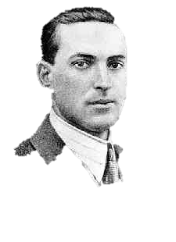
“the unique aspects of human cognition ... were driven by, or even constituted by, social co-operation”
(Moll & Tomasello 2007)

Slide 39


“the unique aspects of human cognition ... were driven by, or even constituted by, social co-operation”
(Moll & Tomasello 2007)
“perception, action, and cognition are grounded in social interaction … hallmarks of individual cognition originated through the need to interact with others”

Slide 40
“the unique aspects of human cognition ... were driven by, or even constituted by, social co-operation”
(Moll & Tomasello 2007)
“perception, action, and cognition are grounded in social interaction … hallmarks of individual cognition originated through the need to interact with others”

Slide 41
Human social cognition, including full-blown theory of mind cognition, is built on capacities for joint action and their exercise.
“the unique aspects of human cognition ... were driven by, or even constituted by, social co-operation”
(Moll & Tomasello 2007)
“perception, action, and cognition are grounded in social interaction … hallmarks of individual cognition originated through the need to interact with others”

Slide 42
Human social cognition, including full-blown theory of mind cognition, is built on capacities for joint action and their exercise.
“the unique aspects of human cognition ... were driven by, or even constituted by, social co-operation”
(Moll & Tomasello 2007)
“perception, action, and cognition are grounded in social interaction … hallmarks of individual cognition originated through the need to interact with others”

Slide 43
Human social cognition, including full-blown theory of mind cognition, is built on capacities for joint action and their exercise.
Objections
1. Full-blown theory of mind cognition comes before joint action
2. Joint action presupposes full-blown theory of mind cognition

Slide 44
Human social cognition, including full-blown theory of mind cognition, is built on capacities for joint action and their exercise.
Objections
1. Full-blown theory of mind cognition comes before joint action
2. Joint action presupposes full-blown theory of mind cognition

Slide 45
Early joint actions involve ...
- sensitivity to others’ mental states
- dispositions to help partners
- partner-specific projects
...
Buttelmann, Carpenter & Tomasello (2009)
Warneken, Chen & Tomasello (2006)
Liebal, Behne et al (2010)

Slide 46


Slide 47
Human social cognition, including full-blown theory of mind cognition, is built on capacities for joint action and their exercise.

Slide 48


Slide 49
‘Ayesha and Beatrice between them lifted the table’

Slide 50
‘Ayesha and Beatrice between them lifted the table’
‘Left Leg and Right Leg between them supported the table’
‘Ayesha and Beatrice between them lifted the table intentionally’

Slide 51
‘Ayesha and Beatrice between them lifted the table’
‘Left Leg and Right Leg between them supported the table’
‘Ayesha and Beatrice between them lifted the table intentionally’

